Slide 1
Recreation & Sports Centre SZÉCHENYI ISTVÁN UNIVERSITY
2024/2025

Slide 2
At Széchenyi University to gain a degree you must obtain:
Degree
Appropriate Strength (TS02)
Endurance level (TS03)
Awareness of one choosen sport (TS04)
Swimming (TS01)

Slide 3
Responsible Organisational Unit: Recreational and Sports Centre: ”RSK” Formelry called: ”TSK”

Slide 4
Perspectives
&
aims:
Gain credit signitures for 4 terms
Choose a sport of your own
Development of abilities, keeping up your condition level

Slide 5
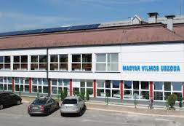
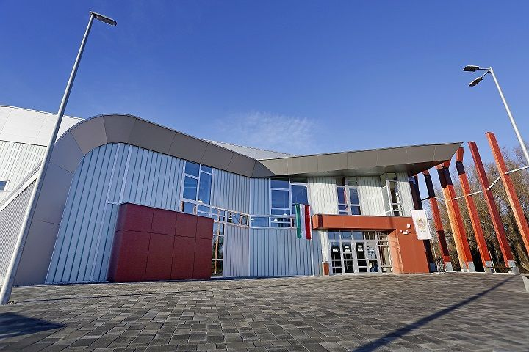
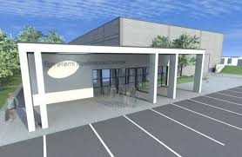
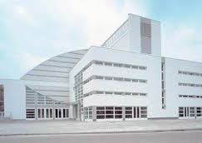
Locations:
University Sports Hall, gym;
Training Hall, gym, climbing wall;
Aqua Sports Center & Magyar Vilmos Swimming pools;
Boat house, kayak – canoe.

Slide 6
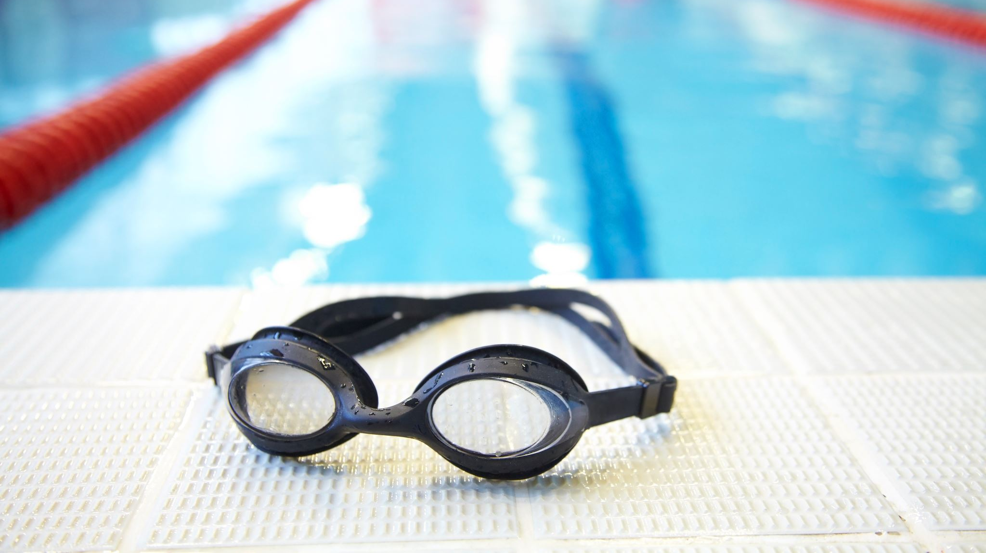
Swimming TS 01

Slide 7
Collection of swimming 8000 m in a term
Swim 1000 m under 30 min (Felame) / 28 min (Male)
Beginners at the end of course complition
Beginners at the end of course complition of 200 m (continuous swimming)
TS01 can be completed by
Location: Aqua and M.V. swimming pools

Slide 8
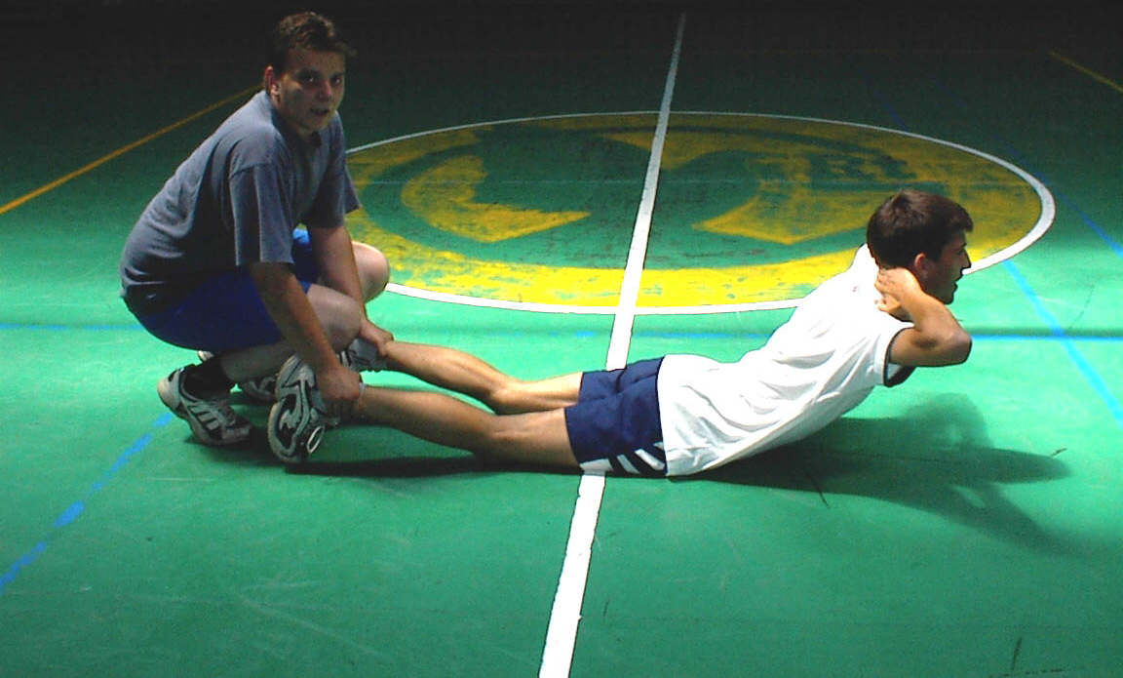
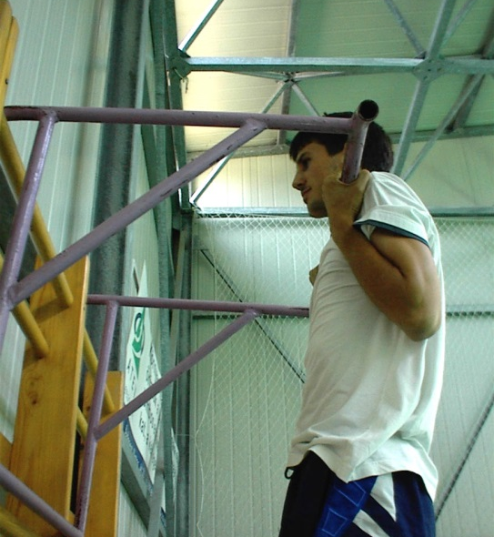
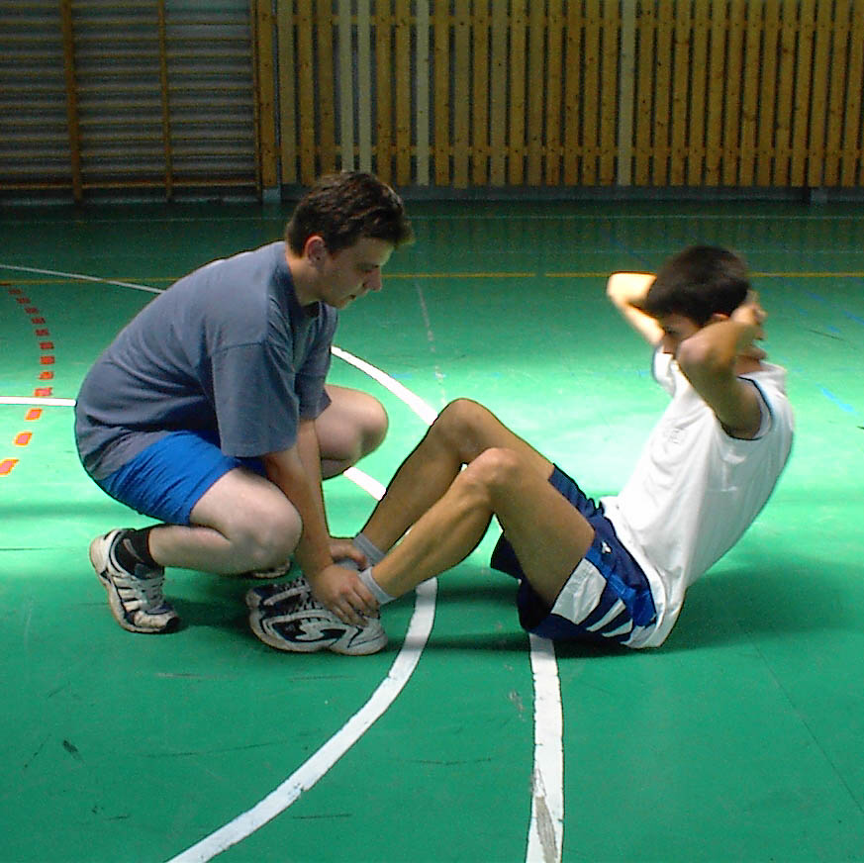
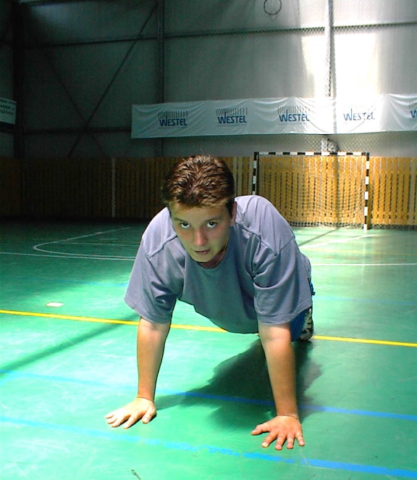
Strength TS 02

Slide 9
TS02 can be obtained
Successful Strength-test presentation
(push ups, sit ups, back extention on floor or on roman chair)
Registered preparatory class attendance 10 times per term
(gym, aerobics, TRX, kayak-kanoe, martial arts, Cross Fit, wall climbing)
Locations: University Gyms, Sports Halls, Off-campus sports facility, Boat house.

Slide 10
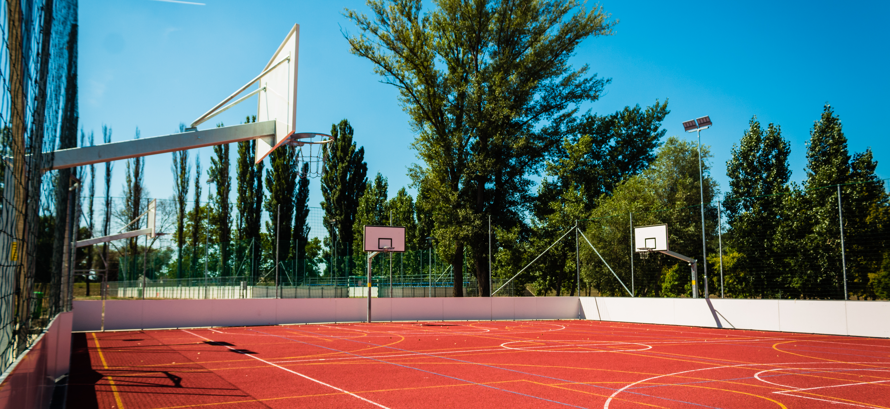
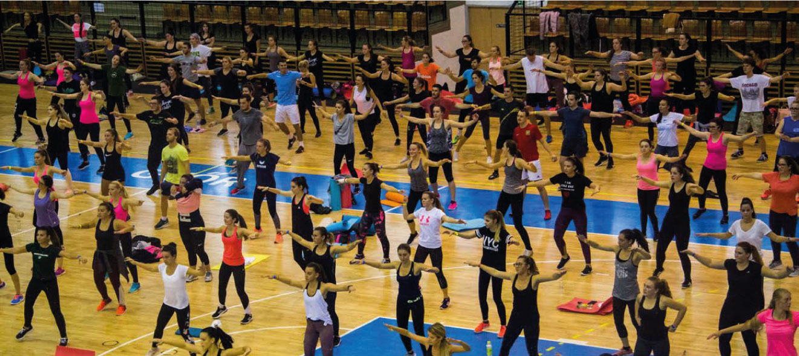
Aerobic Endurance TS 03

Slide 11
TS03 can be obtained
Run 30 km in a term
(during registered lessons, within one choosen term)
Registered preparatory class attendance 10 times per term (running, aerobics, TRX, kayak-kanoe, martial arts, Cross Fit)
”Püspök-forest” Running race
(SZE-Days, within given time limit)
Spiro-ergometric lab examination

Slide 12
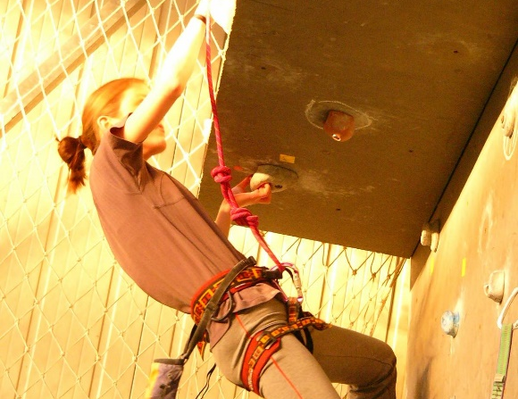
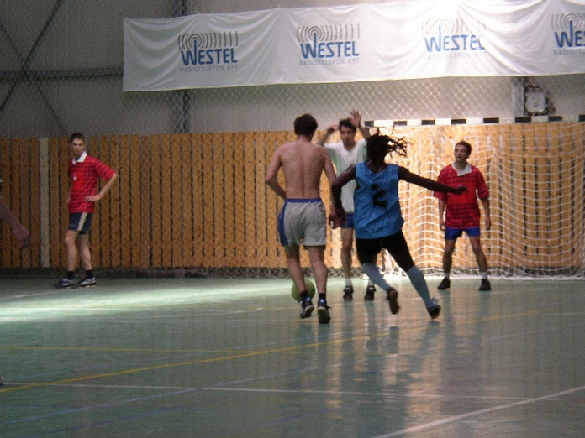
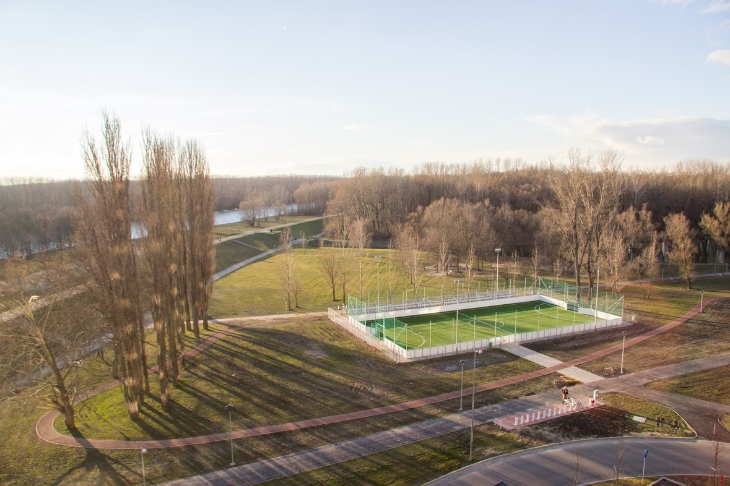
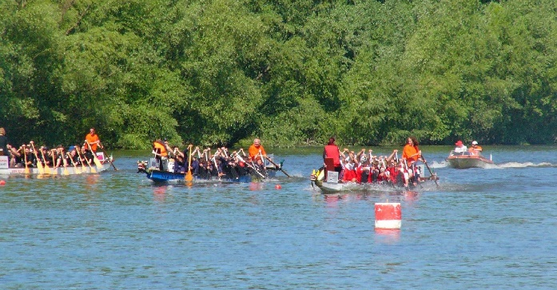
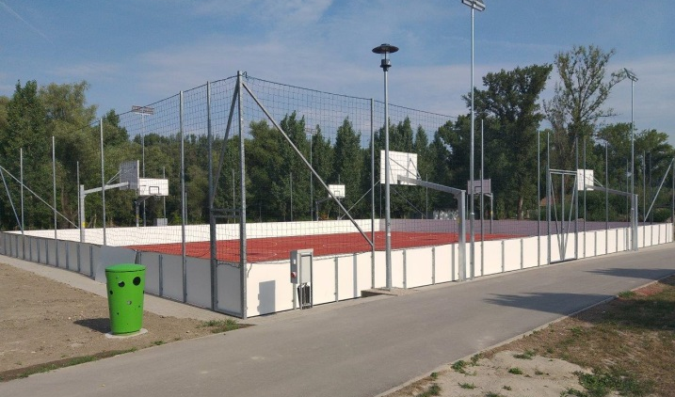
Sport knowledge TS 04

Slide 13
TS04 can be obtained
Leasure sport events (organised by Sport Office): University Days (SZEN), Faculty Days, International University Sports Day
Registered preparatory class attendance 10 times per term (Running, gym, wall climbing, ball games, aerobics, extrem-sports, martial arts, water sports, yoga and dance etc.)

Slide 14
Extracuricular Use Sports of Facilities
Active Student Card (Hallgatói kártya)
Active membership by paying 5000 HUF per term at
Ms. Gréta Borda
sports organizer
borda.greta@gmail.com
Student’s Sport office (University Sports Hall. 1st floor)

Slide 15
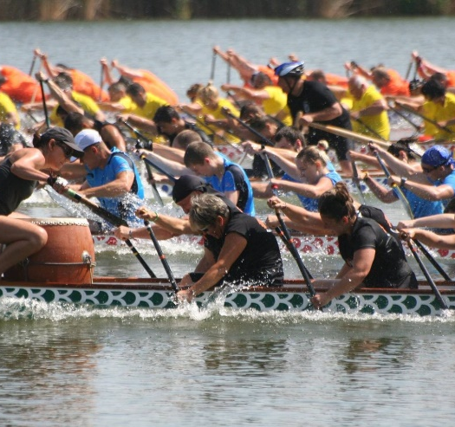
Dragon boat recruitment
10-10 students per training.Total: 40 people
Training dates: until 30 October 2023
Goal: H. University Championship
Mondays & Thursdays: GYVSE '17:30-18:30
Tuesdays: GYM, University Training hall
20:00-21:00
1 Nov 2023 to 2024 March Tues & Thurs:
GYM, University Training hall: 20:00-21:00

Slide 16
https://tsk.sze.hu
Timetable:
https://tsk.sze.hu/images/Orarend/2022_23_2/SZE_PE_Timetable_2022_23_2.pdf

Slide 17
Thank you for your attention!
Dr. Zsolt Bálint Katona zsbkatona@sze.hu

